Slide 1


Apra Chapter Strategies That Worked Martha Ortinau Rowe
President, Apra-IL
Andrew Gutierrez
Vice President, Apra-IL

Slide 2
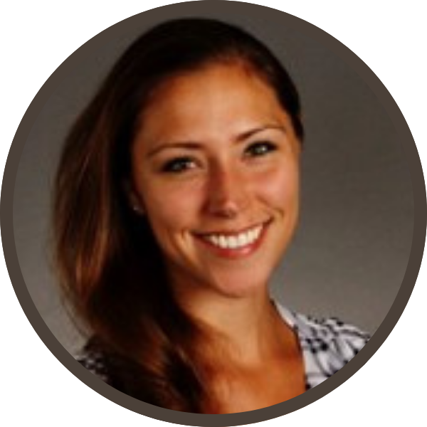


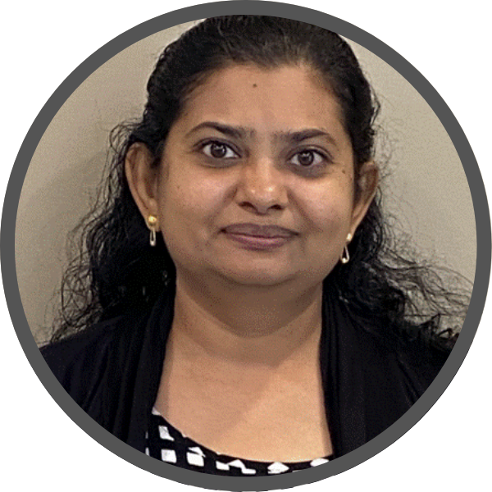

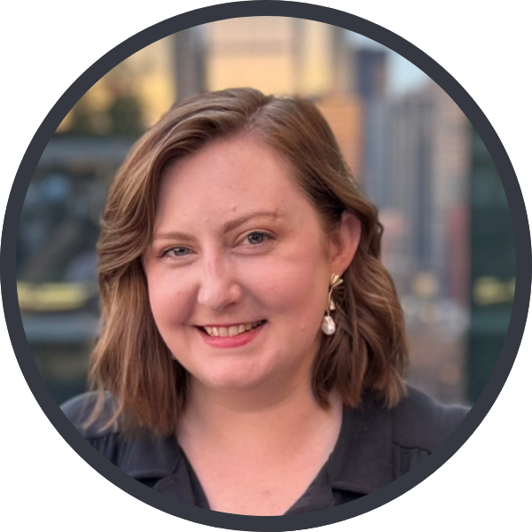

Meet the Apra-IL Team
Martha Ortinau Rowe
President
Andrew Gutierrez
Vice President
Melanie Pozdol
Secretary
Priya Balachandran
Treasurer
Sam De Sando
Director of Membership
Taylor Scott
Director of Programming
...And Special Recognition To
Pete Kotowski, President Emeritus

Slide 3


Apra-IL By The Numbers
94 Active Members
43 Organizations

Slide 4
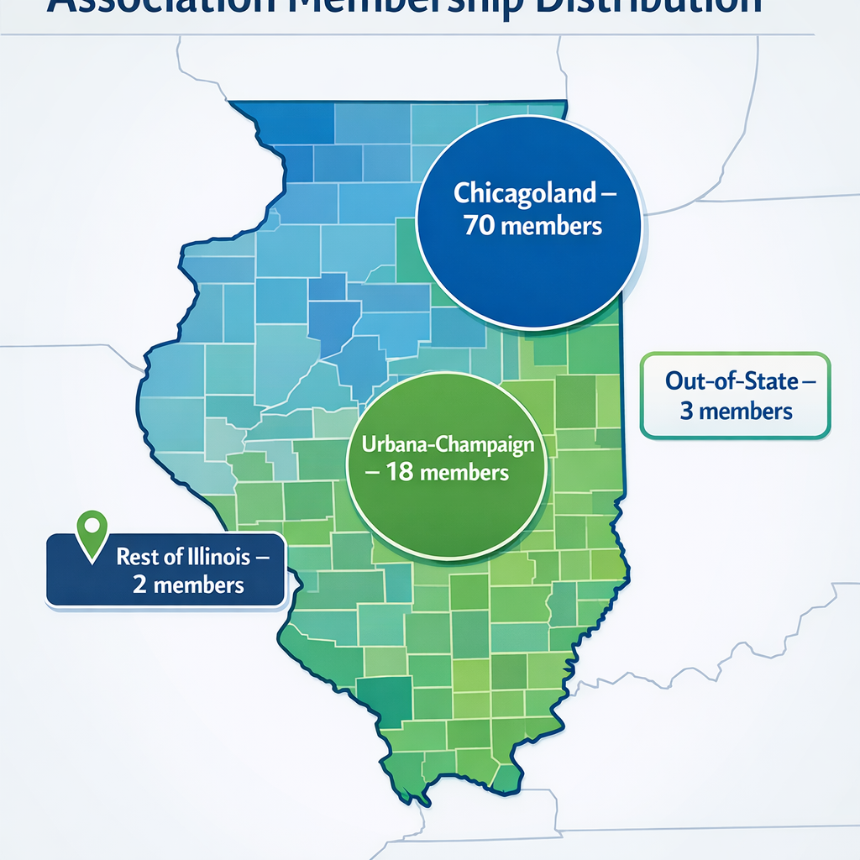
Apra-IL By The Numbers

Slide 5
2025 – A Banner Year for Apra-IL!
Hosted 11 events
336 event attendees
In-person/Virtual Symposium
$9,460 in revenue for the year (a new record!)

Slide 6

1st Strategy – Define & Increase Member Engagement

Slide 7
1st Strategy – Define & Increase Member Engagement
Active members engage through at least one within the last six months
Goals to increase revenue
More robustly engage current members
Acquire new members
Logging into Apra-IL
Attending an Event
Clicking through a Link
Notes:
Define & Revenue flows from engagement
Themes you'll hear throughout: - Collaboration with board: None of this would be possible without all of us working together, collaborating, identifying opportunities for improvement.
all on Slack communicating
formal goals for the year with check-ins throughout the year at our board meetings.
Have a plan
Communicate, communicate, communicate

Slide 8
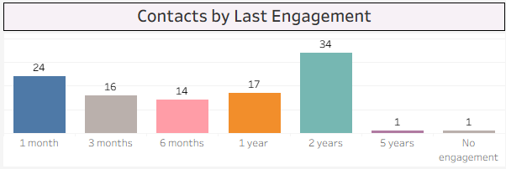
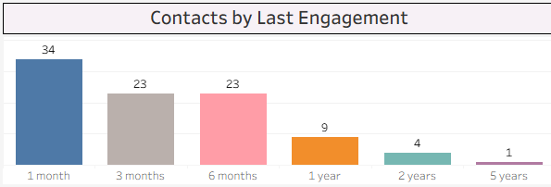
Member Engagement Throughout 2025
January 21st, 2025:
50.4% of members engaged within previous six months
January 21st, 2026:
85.1% (!) of members engaged within previous six months
Notes:
We set this metric up at the beginning of the year – at that time, only half of our members were engaged within that six month window. We even had some members who had no engagement in over a year, two years, and more.
Fast forward 12 months to now and after our work throughout 2025, that percentage engaged within six months is up to 85%. A real testament to the hard work our board has put in.

Slide 9

WildApricot Member Association Data – A Digression

Slide 10
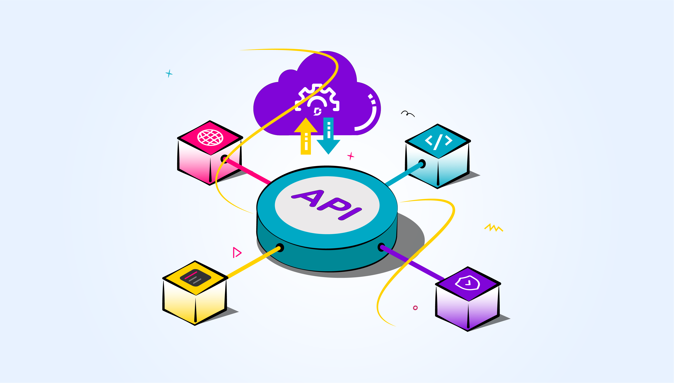
APIs – An Introduction
Application Program Interfaces
Request/retrieve data from the API for use with another application ("GET")
Push data back to original application through the API ("PUT")
A key part of analytics environments for prospect research!
iWave, Zillow, WealthX, DonorSearch, Candid, Redfin, RelSci, LinkedIn, SEC, and much more.
Notes:
What I discovered is that WildApricot has an API. If you don't know what APIs are, WikiPedia tells us that they stand for "Application Program Interface" and act as an interface for a particular software that allows for connection and services to other pieces of software.
Generally there's two things you can do with an API – you can request information (GET request) to download, or you can push data back to the API and the original software that it acts as the interface for ("PUT" requests)
Even if you're unfamiliar with APIs, if you work in prospect research chances are you've used data that has been acquired through an API - iWave, Zillow, WealthX, DonorSearch,Candid, Redfin, RelSci, LinkedIn are all examples of APIs I've used to capture external information on prospects and append it to an internal data environment.

Slide 11
WildApricot API Overview
WildApricot API
Contacts API
Membership API
Events API
Finances API
Emailing API
Online Store API
Contacts
Contact Field Values
Membership Levels
Event Information
Event Registrations
Event Registration Types
Registration Fields
Event Tags
Invoices
Payments
Payment Allocations
Tenders
Refunds
Sent Emails
Draft Emails
Email Recipients
Email Link Clicks
Orders
Products
Notes:
So in my exploration, I found that WildApricot had an API and that there was some documentation for it on a website called SwaggerHub. So in familiarizing myself with the API, I was able to write a suite of programs with Python to extract all the information from our WildApricot account listed here – everything from contacts, to events, to finances, emails, and more.
I also was able to do PUT requests. One thorn in our side for example was email unsubscribes – in WildApricot, the email functionality doesn't quite talk back to the Contacts section; so when someone would unsubscribe from our emails, we would have to manually go back to their contact record in the system and flip their email preference to Unsubscribed. Using a "put" request in Python, I was able to automate that function and update any unsubscribing contacts email preferences programmatically through the API.
But once you have acquired a swath of data like this from an API, that then allows for different types of analyses, for linking different datasets together, and for reshaping and creating new data points...
Go to Dashboard

Slide 12

2nd Strategy – Benchmarking With Other Chapters

Slide 13
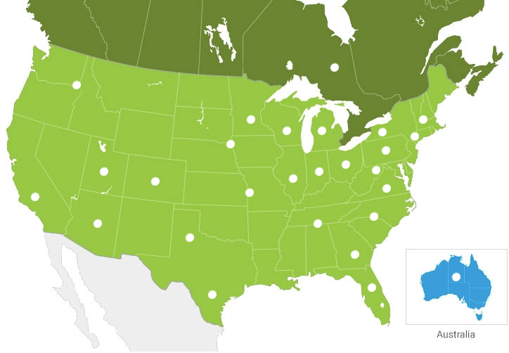
2nd Strategy – Benchmarking With Other Chapters
Keep tabs on what your peer chapters are doing!
Membership levels, pricing, and benefits
Events and programming
Communications
Sponsor levels and benefits
Notes:
We have over 30 chapters of Apra across the country and beyond. Many of the ideas for new things we tried in 2025 came from keeping tabs on and noticing what some of our peer chapters were doing.
To that end, our Illinois Director of Membership Sam de Sando of the Chicago Botanical Garden did fantastic work in benchmarking the rest of our peer chapters, compiling an in-depth spreadsheet of other chapters membership levels, pricing and benefits, sponsor information, events and programming and more. If something works for one chapter, chances are it works for yours

Slide 14

3rd Strategy – Consistent Chapter Communications

Slide 15
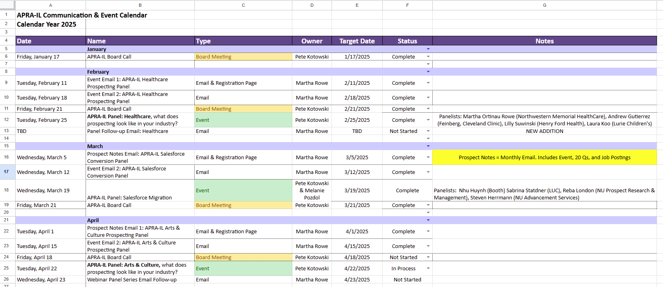
First Step – Communications Calendar
Notes:
Communications calendar: having a plan is half the battle. Execute to the plan, assign & ensure deliverable timelines.

Slide 16
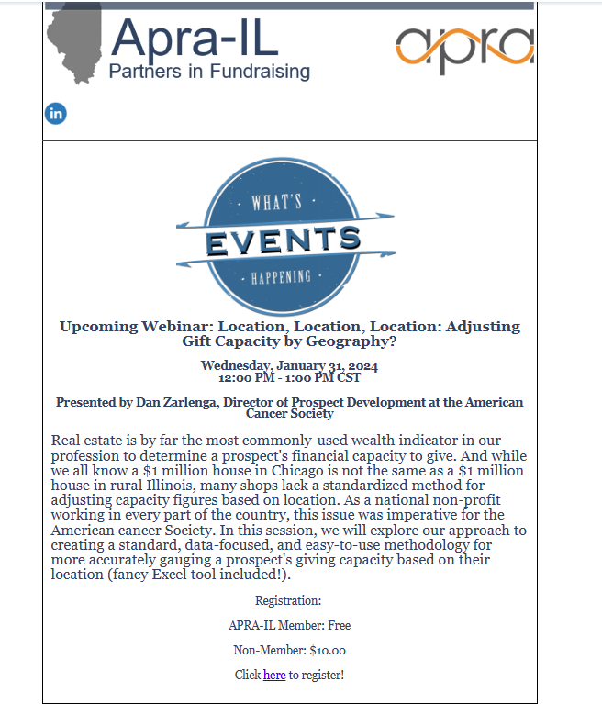
Prior State of Chapter Communications
Notes:
Up until this 2025, chapter communications were almost entirely reactive – we generally only sent communications out when we had an event to promote. We also had a very barebones, raw HTML-type design. Just really no-frills, reactive chapter communications. Martha and I have both worked in annual giving in the past which involves a lot of digital communications, and we both had a general though that we could be doing more.

Slide 17
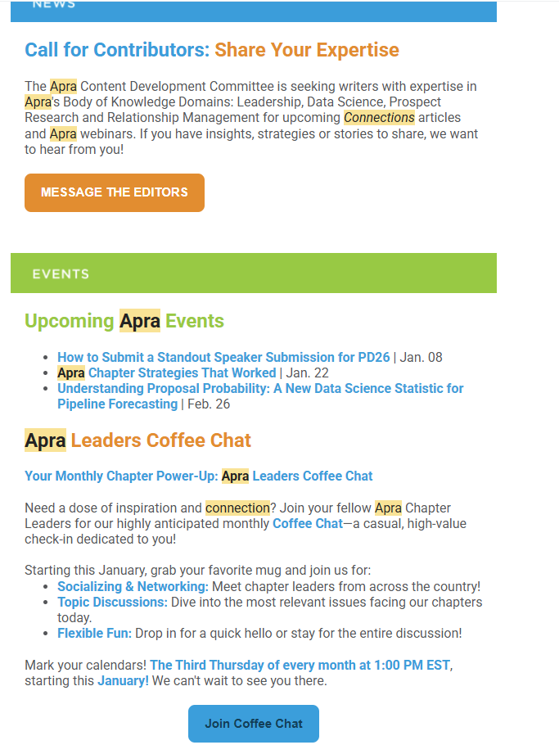
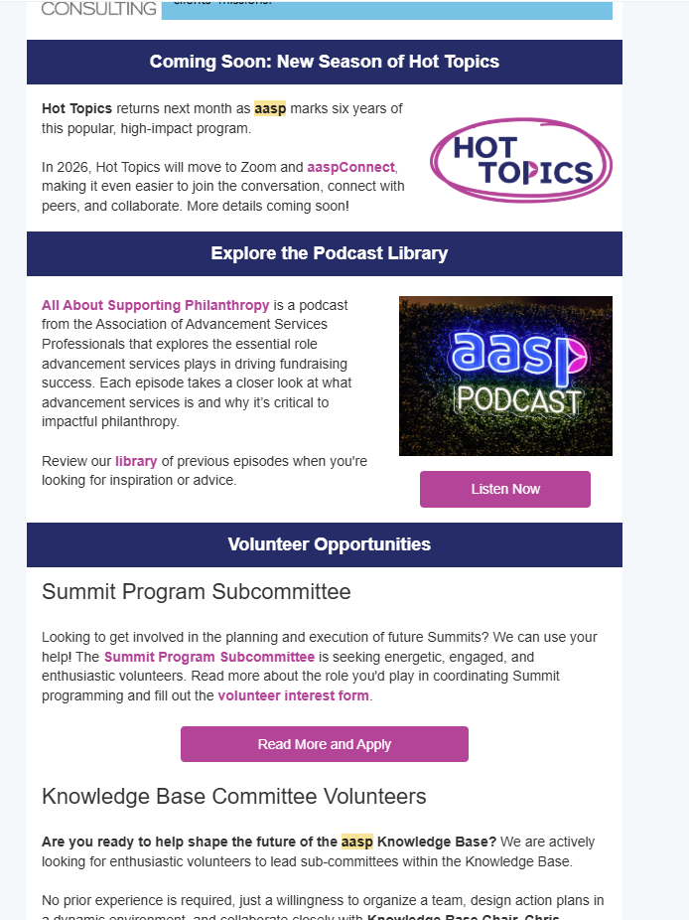
Benchmarking Against Other Associations...
Notes:
Which led me to wonder if what we really needed was a regular newsletter. When I took a look at what other professional associations did for their communications, I noticed a common theme – many of them were set up in the style of "snippet of item", "big link button", and then "divider". On the left is big Apra's newsletter, and on the right is aasp, the Association of Advancement Services Professionals. So I took note of those trends, posted up in the lab for a bit, and came out with a newsletter of our own which we entitled "Prospect Points". We send this in the first week of every month to each contact that we have in our WildApricot system.
Wanted to align with big Apra – actually went in and got the hexagonal HTML color code for the shades of orange and blue that big Apra uses and use the exact same shades in our newsletter.
Show Prospect Points example here

Slide 18
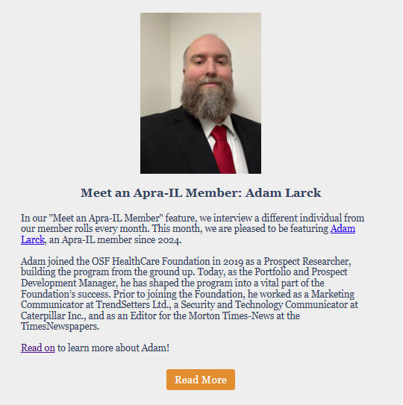
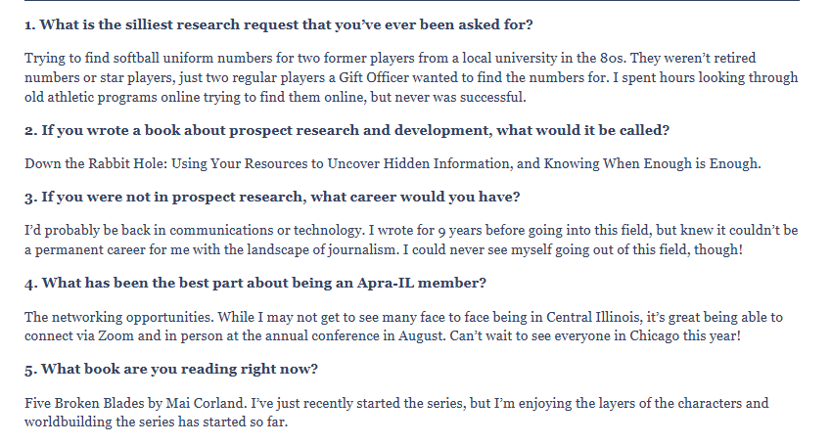
"Meet an Apra-IL Member"
Notes:
I'll highlight several individual segments of our newsletter that we implemented in 2025 that specifically helped push member engagement. One was a "Meet an Apra-IL Member" segment, where we feature a different member from our member rolls each month in a blog post. We have a list of 20 questions that we send out to our members who participate in this, and we instruct them to pick 5 to respond to. We also implemented a new checkbox as part of our new member application process where new members can indicate whether or not they'd like to be a Featured Member at a later date. If they check yes, we send them the questionnaire automatically, allowing us to have a proactive backlog of member questionnaires ready to go so we don't have to be actively reaching out to people.

Slide 19
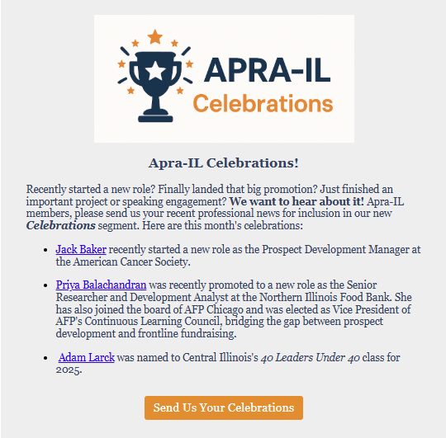
Apra-IL Celebrations!
Notes:
Celebrate members' promotions, new roles, career news, and more. Have also used this slot to call out returning members when they renew, and new members when they join for the first time.

Slide 20
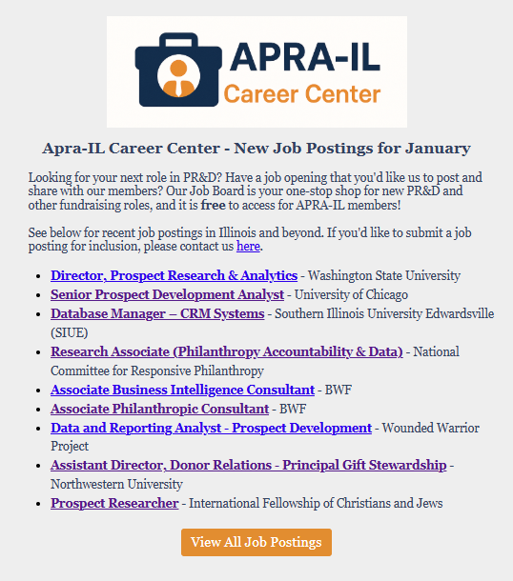
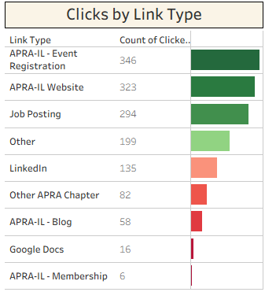
Jobs, Jobs, Jobs
Notes:
Noticed in email link click data that job postings were one of if not the most popular link clickthroughs in Prospect Points (makes sense, most people join a professional association to help with career advancement).
Show job postings list here
Once a week I go out to LinkedIn and do just a few job searches. I search for Prospect Research within Illinois, and I search for Prospect Development within Illinois. If I see something that is national-based with a remote option come across my feed, I'll include that as well.
Python program imports spreadsheet data into data warehouse, uses HTTP requests library to check each URL in list, make sure page is still active; if not, the posting is marked as inactive in the data warehouse. Program then spits out raw HTML code into a text file which formats it into what you see on the website – that piece also makes sure that only postings from within the last 3 months are pulled in, as there really are a lot of ghost jobs being posted out there that don't ever come down. So in this way, the postings on our website are kept current, well-organized and up-to-date with only just a few minutes of weekly work. I also created a condensed version of the same program that outputs just the 10 most recent job postings into the HTML for use in the Prospect Points newsletter.
Show Jobs Postings page here
Have posted over 180 jobs since I started doing this last year. Mention Salary Survey idea

Slide 21
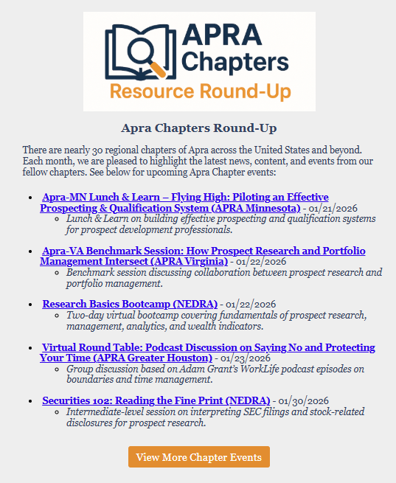
Aggregating Events from Our Peers
Notes:
Plugging events from our other chapters. If we are going to benchmark and try and emulate our peer chapters, it's only right that we plug their events and try and give back in some way.
Show Chapter events list here
Since most chapters also use the WildApricot system, I was able to approach this programmatically as well. I wrote another program with Python's URLParse library to scan through every chapter's WildApricot events page and parse out the information on their upcoming events into a text blob. Then I'm able to feed the text blob for each chapter into OLlama, which is a locally-run large language model that runs right on your desktop in order to generate little blurbs for each event. Finally, similar to what I've done for the jobs program, I can output more custom HTML that formats the event information and can be dropped right into our newsletter

Slide 22
Prospect Points - The Final Word
7,209 individual sends
43.4% average open rate
11.6% average click rate
1,459 link click-throughs
Notes:
A good email open rate generally falls between 15% and 25%
A good email click-through rate (CTR) generally falls between 2% and 5%, with anything above 3% considered strong

Slide 23

4th Strategy – Consistent Monthly Webinars
Notes:
Engage with Board Members to identify new speakers: Priya with Social Services, Melanie with Arts & Culture and Salesforce conversion

Slide 24




4th Strategy – Consistent Monthly Webinars
Standardize & Communicate
Scheduled & Communicated 3+ months in advance
Establish a theme to tie the year together
Engage with board members to identify new speakers
What is prospecting in your industry?
Standardize format
Standardize questions
Add a webinar store! Free for members
Notes:
Establish a theme to tie through the year: What is prospecting in your industry?
Higher ed, healthcare, arts & culture, social services
Teach constituents what to expect by being consistent and relevant
FY 26 plan to establish another theme and fill with content

Slide 25
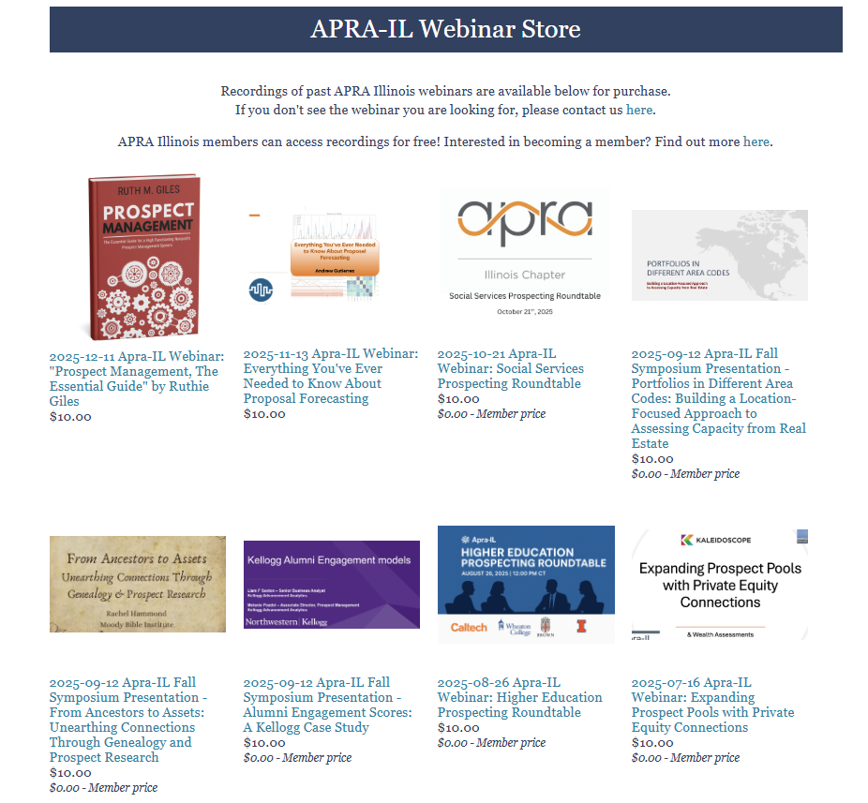
Webinar Store!
On our online Apra-IL webinar store, we now host recordings for 25 different webinars previously presented to our members, with some recordings dating back to 2020.
In 2025, our for-sale webinars were downloaded 22 times.
12 Apra-IL members took advantage of the free webinar store benefit and downloaded past content.
10 non-members purchased webinar recordings, netting an additional $100 in 2025 revenue.
# Webinars available
# Webinars downloaded
$ Revenue
Notes:
Added a webinar store: recorded each month's webinars & Symposium
Idea from Apra-MN – thank you!
Let your past effort for identifying and securing webinar presenters continue to pay monetary dividends years down the line.

Slide 26

5th Strategy – In-Person Networking Events

Slide 27



5th Strategy – In-Person Networking Events
Monthly newsletter
Save the Date
Invite
Week-of Reminder
Reminder
COMMUNICATE &
Notes:
Credit to Taylor Scott
Communicate, communicate, communicate – used main communication device (monthly email) as well as unique opportunities to engage & reminders closer to the date
Share on social media (LinkedIn)
Separate landing page and registration pages for the events
Learnings: set a budget beforehand... drink tickets are a good solution!

Slide 28
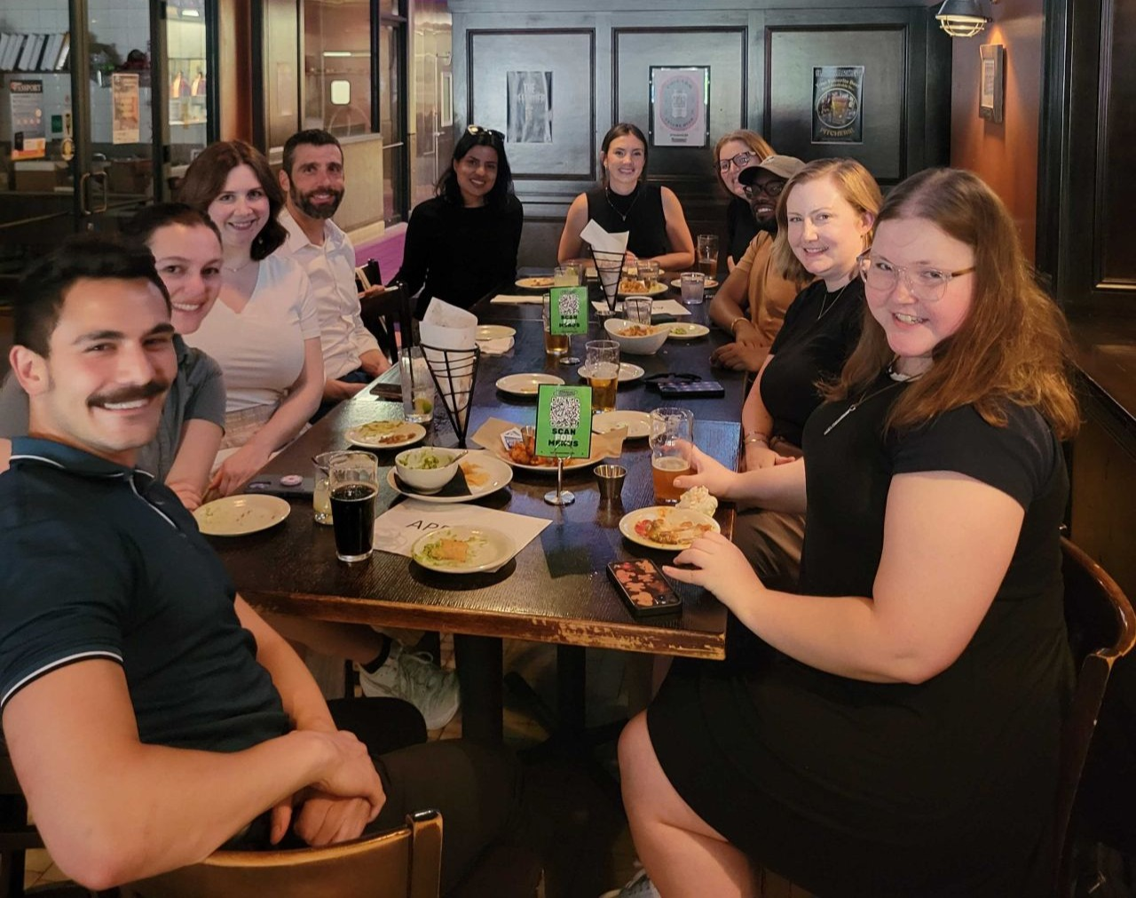
5th Strategy – In-Person Networking Events

Slide 29

6th Strategy – In-Person/Virtual Symposium

Slide 30
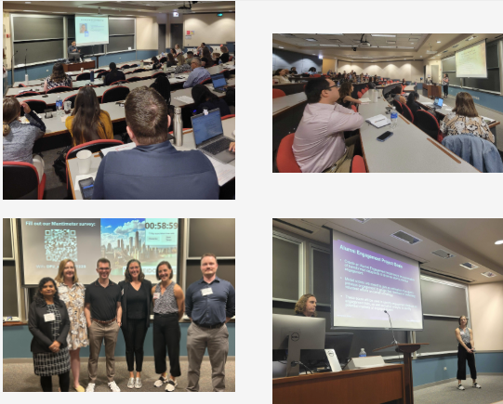
6th Strategy – In-Person/Virtual Symposium
Held on Friday, September 12th at DePaul University Conference Center in Downtown Chicago.
For the first time, we organized a hybrid event; attendees could come in-person, or view a livestream of the event online via Zoom.
This allowed us to open up the event to members who live outside the Chicagoland area who normally would not have been able travel to attend in-person, as well as attendees from outside Illinois.

Slide 31
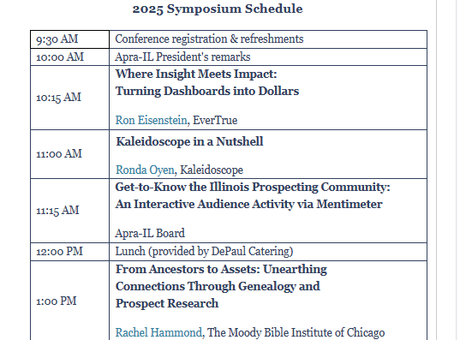
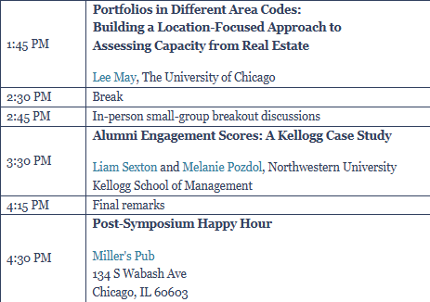
New Event Strategy: Call for Presenters
Notes:
Launched in end of May 2025, deadline beginning of July 2025. First two weeks, the link was shared only with our active, dues-paying members as we wanted to give them first crack at being able to present. We received a half-dozen submissions, which basically outsourced the work we would have had to do to identify, vet, and reach out to speakers.

Slide 32
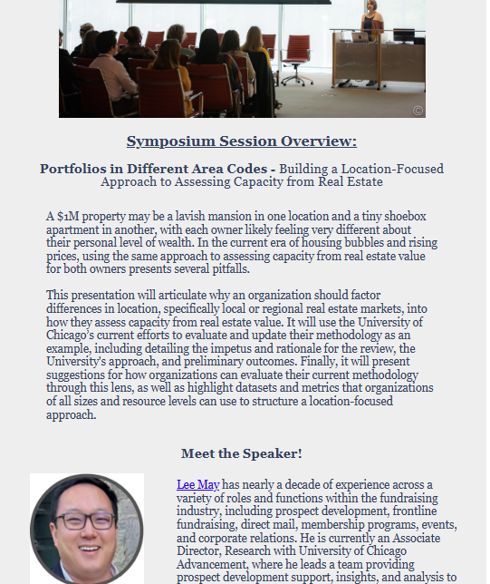
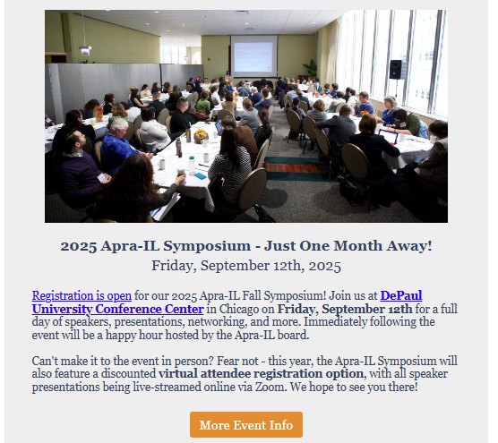
New Event Strategy: Advance Promotion
Notes:
Opened up registration in July, about six weeks out from the event. We were able to do a formal announcement of the event with the registration link, and we also had the full speaker lineup, schedule for the day, and pricing ready to go as part of the announcement. We did four separate Symposium-specific email communications at six weeks out, 4 weeks out, 2 weeks out, and 1 week out. Because we had four selected presenters, we were able to do a "Symposium Session Overview" and "Meet the Speaker" feature in each one of those emails, where we highlighted one of the day's sessions. We were also able to plug the event heavily in our August and September editions of Prospect Points. In this way we were really able to blanket the airwaves so to speak and build anticipation for the event for our members.

Slide 33
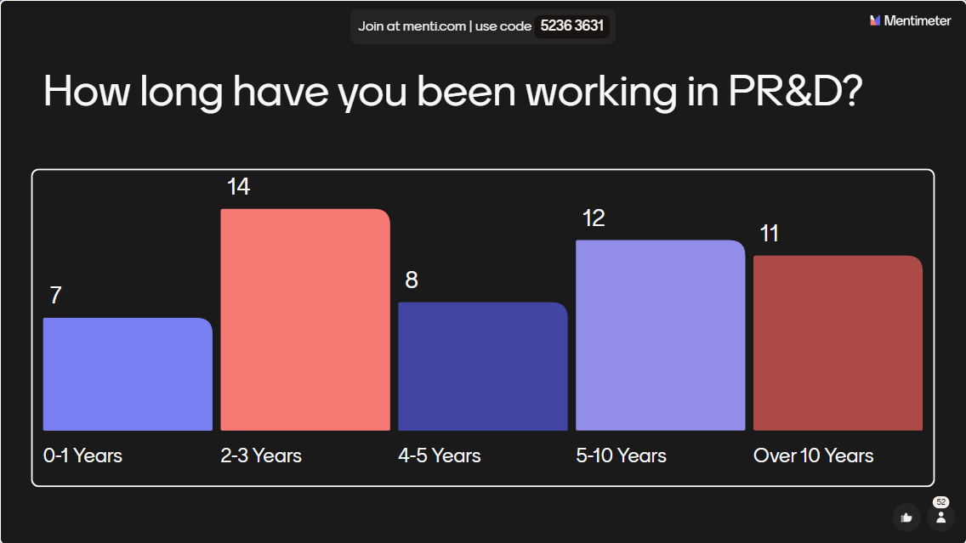
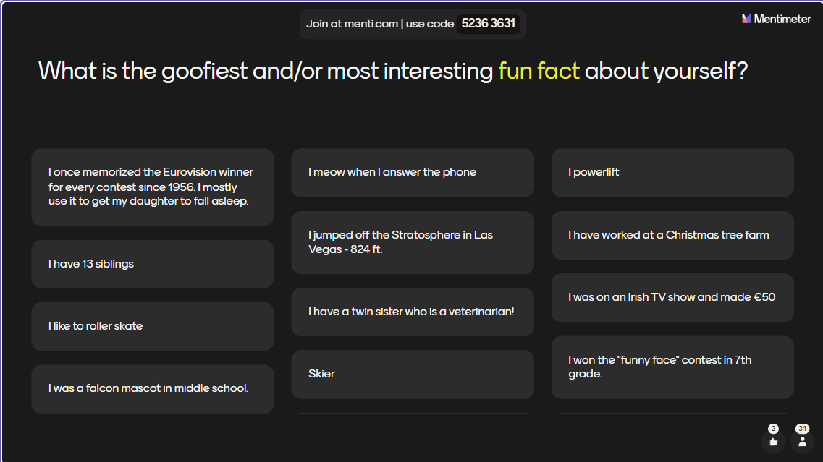
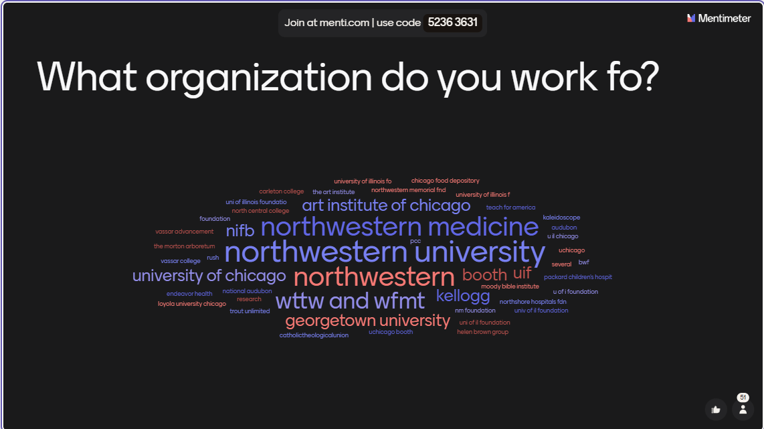
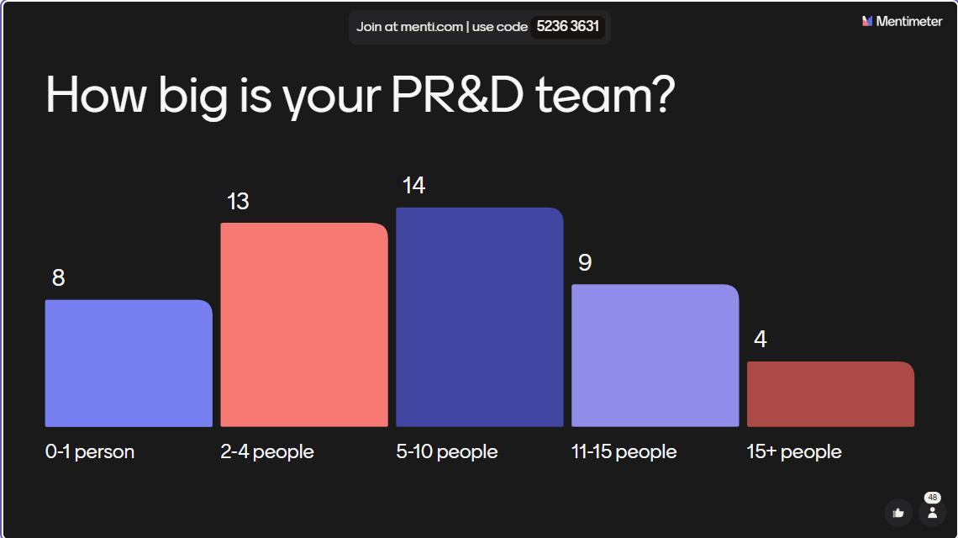
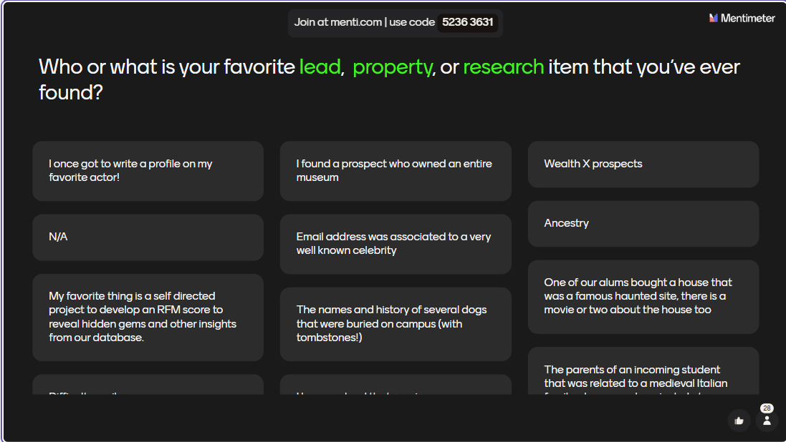
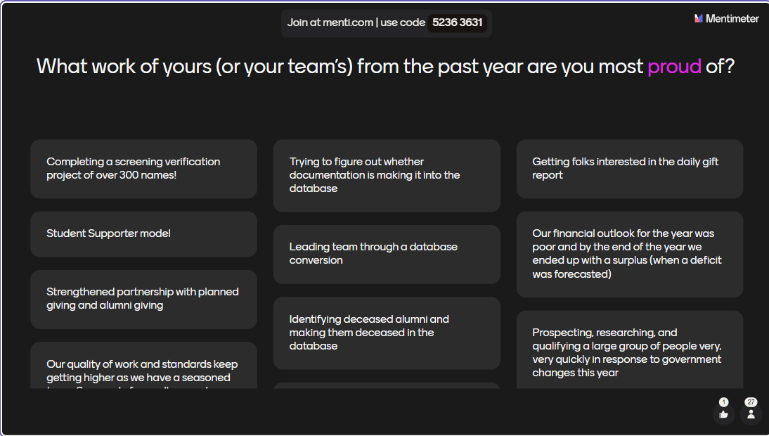
New Event Strategy: Interactivity!
Notes:
QR Code, 13 questions, left QR code up before event and between presentations urged attendees to use the QR code to fill out the survey (ensure no dead space during first 10 minutes of segment)

Slide 34
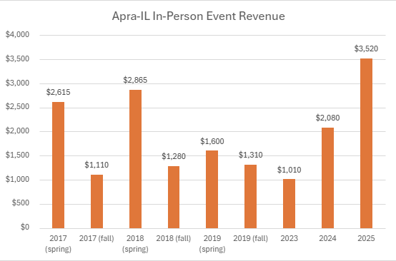
2025 Symposium By The Numbers
Notes:
So how'd we do? Well, our 2025 event experienced the highest attendance we've had for any of our major conference events in the last ten years, and was tied for the second-most number of unique institutions represented among those attendees.
It also set a record for conference event revenue, eclipsing $3,500 in revenue for the first time with our expenses kept to about $1,000, allowing us to turn a solid profit.
All-in-all a fantastic win and something to build on for 2026

Slide 35

7th Strategy – Targeted Outreach to Major Institutions

Slide 36
Snapshot of 2025 Revenue
Notes:
First, I wanted to harken back to one of the themes that's popped up throughout this presentation, which is to engage your members. Here's just a quick snapshot of our revenue in 2025 that shows why that's so important – we just showed how we did really well with event revenue in 2025, but even with that being the case, membership dues were still our biggest bucket of revenue for the year at 40%. So engaging and stewarding your members is so important, which leads us to our final strategy – targeted outreach to institutions

Slide 37
7th Strategy – Targeted Outreach to Major Institutions
Know who the major institutions are in your state/chapter market(s).
Take a look at your member rolls, event attendance, and digital engagement. Which institutions are actively engaged and represented? Which ones aren't?
Develop strategies to get your "missing" institutions involved; leverage personal board connections to invite them to events, or consider asking them to present a webinar to showcase their good work.
Take notice when someone from a new shop engages for the first time! Use the opportunity to welcome them and get them (and their team) more involved.
Don't forget about retention! Make sure you are stewarding your member institutions who are already involved with your chapter; be aware of when their memberships are lapsing and keep an eye on their engagement.
Notes:
Institution by Institution strategy
As one example, at one point last year in looking at our data that I've shown throughout our call today, I noticed that one of our major institutions who comprise a significant portion of our member base and member revenue were due to lapse in a few months' time, and that a good chunk of their members were outside of our six-month engagement window. Wanting to make sure we kept them in the fold and that they remained engaged, we reached out and offered the opportunity to present one of our monthly webinars and highlight work of theirs that they were proud of. They were extremely appreciative of the opportunity, ended up having a great time presenting their webinar, and when it finally came time to renew their employees' memberships, they not only renewed everyone but they added a few new members who weren't previously included as well.

Slide 38

Looking Forward to 2026...

Slide 39
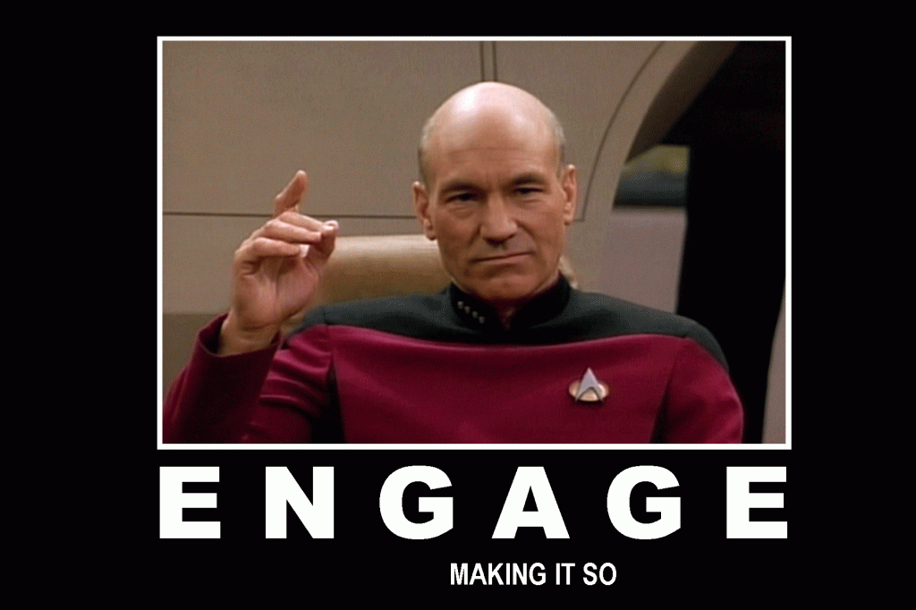
Looking Forward to 2026
If we want to do it, write it down – with accountability
Plan out a full year in advance, break it down by quarter
More volunteer opportunities & build stronger board pipeline
Sponsorship opportunities with revamped benefits and branding
In-person networking events that are more activity based
Collaboration with other chapters
Resources page (what does Apra-IL offer?)
Virtual networking opportunities for "office hours" and more causal engagement across distances
Broader reach outside of the city
Travel grants
Notes:
Each goal has a goal owner and second-support person

Slide 40
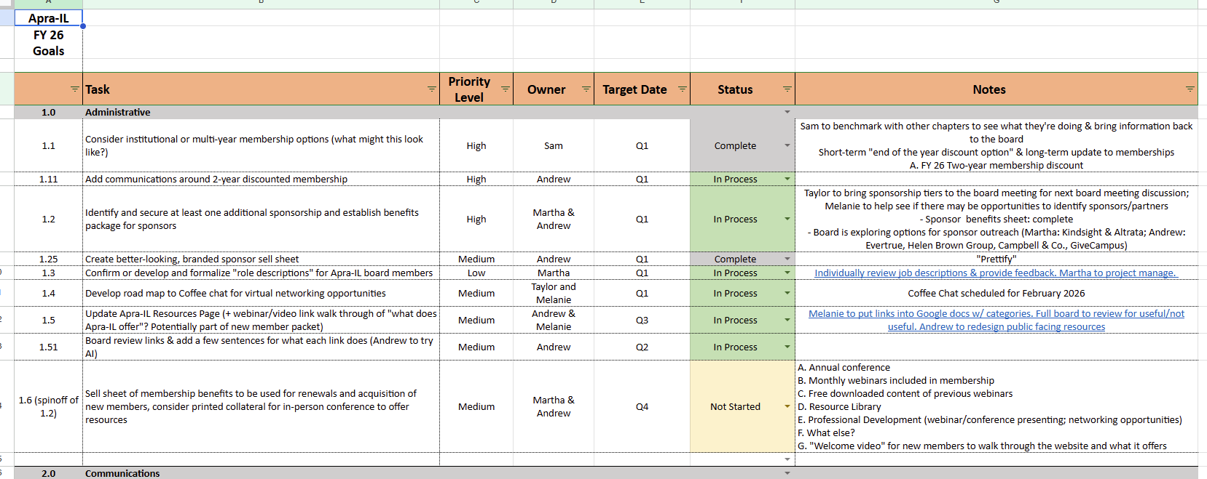
Establish Board Goals For The Year

Slide 41
Questions? apraillinois@gmail.com

