Slide 1
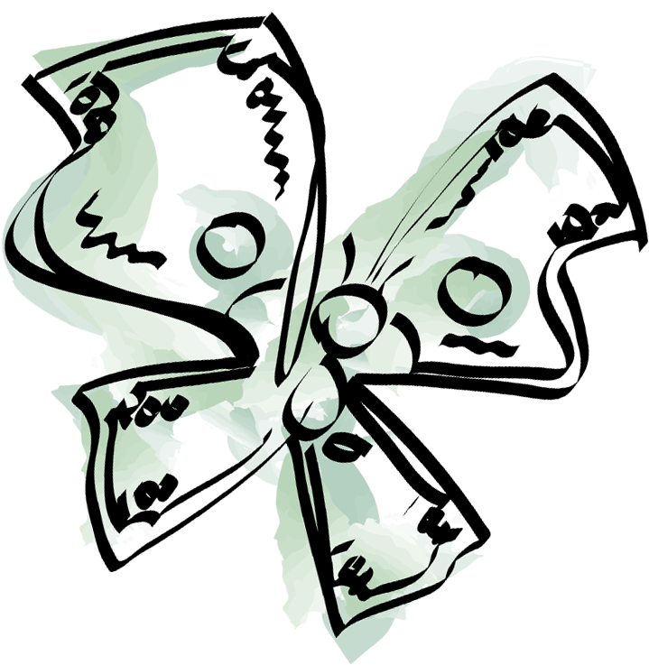
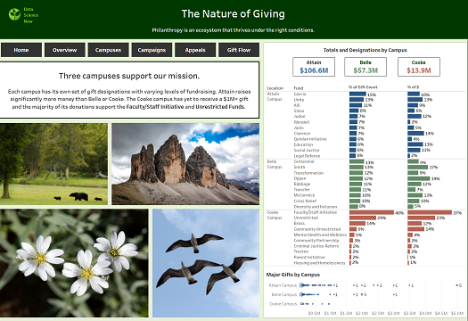
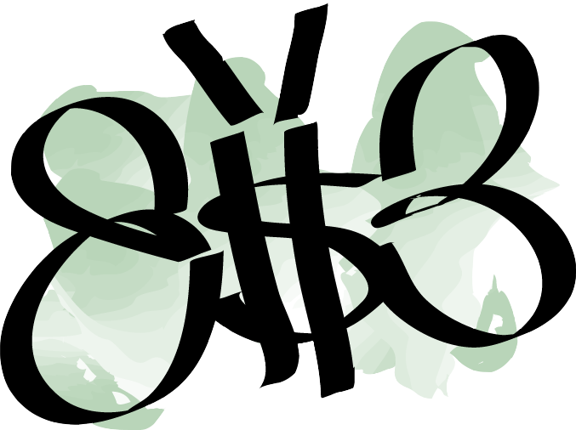
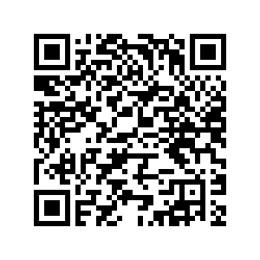
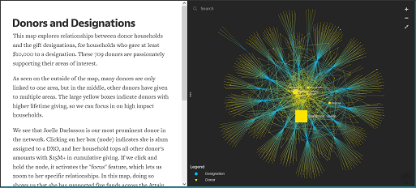
The Nature of Giving California Institute of Technology
Image from submission
Philanthropy is an ecosystem that thrives under the right conditions. This project takes a three-pronged approach to catching gifts in their natural habitat. First it provides context on giving behavior and patterns through a dashboard, walking through environmentally themed insights. Next, it explores the fundraising team and donors and their designations through a pair of relationship maps, as nature is full of connections. It concludes with a cluster analysis based on the butterfly lifecycle to help the organization segment and approach donors appropriately. These efforts help philanthropy to take flight and reach new heights.
kellyd@caltech.edu
jen@caltech.edu
Tools: Tableau, Kumu, R
QR code placement
(Apra to create)
Recommendations
Hatchling (long lapsed) donors should not be our focus unless they signal renewed interest.
Caterpillar (steady, lower level) donors should be stewarded through the annual fund or asked for a planned gift.
Emerging donors (unexplored potential) should be qualified if assigned and further engaged if unassigned.
Butterfly (loyal, major) donors should be cultivated and solicited.
Image from submission

