Slide 4
ACKNOWLEDGEMENTS
Jenna Majzoub | Director of Prospect Management and Research
Olive Buchholz | Prospect Management Analyst
Peter Reiker | Prospect Management Analyst
Bill Tran | Prospect Management Analyst

Slide 5
“In the grand Kingdom of Apra, the time has come for a new fundraising campaign.

Slide 6
“In the grand Kingdom of Apra, the time has come for a new fundraising campaign. Preparations for this legendary quest, titled Apra's Gate, are underway.

Slide 7
“In the grand Kingdom of Apra, the time has come for a new fundraising campaign. Preparations for this legendary quest, titled Apra's Gate, are underway. The executive royalty, seeking advice and wisdom to guide them through the quest, have summoned the revered Analysts of the Round Table.

Slide 8
“In the grand Kingdom of Apra, the time has come for a new fundraising campaign. Preparations for this legendary quest, titled Apra's Gate, are underway. The executive royalty, seeking advice and wisdom to guide them through the quest, have summoned the revered Analysts of the Round Table. Their mission: to forge a path ensuring financial prosperity for the future of the Kingdom…”

Slide 9
Exploratory Data Analysis

Slide 10
Exploratory Data Analysis
Of the four campaigns already executed, only three show substantial contributions
Clarity Campaign only shows 1 total gift of $150
The other three campaigns show wide fluctuations in duration, average gift amount, gift count
Most common primary unit in each campaign is Attain Campus, most common assignment unit in each campaign is DXO

Slide 11
Exploratory Data Analysis
Of the four campaigns already executed, only three show substantial contributions
Clarity Campaign only shows 1 total gift of $150
The other three campaigns show wide fluctuations in duration, average gift amount, gift count
Most common primary unit in each campaign is Attain Campus, most common assignment unit in each campaign is DXO

Slide 12
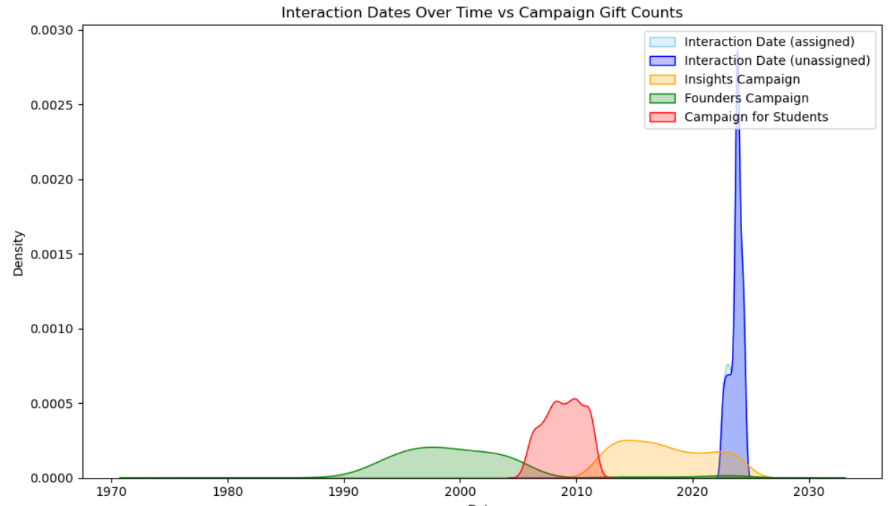
Exploratory Data Analysis
Interactions seemingly do not correspond to any previous campaigns

Slide 13
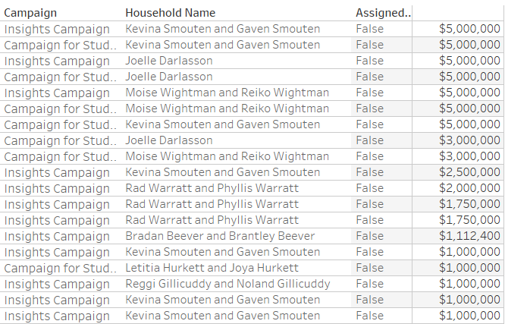
Exploratory Data Analysis
The largest gifts are coming from unassigned donors
Assignment does not seem to correlate with higher giving amounts

Slide 14
Exploratory Data Analysis
Assumption #1: DOs utilize self-assignment when building their portfolios
Assumption #2: DOs are not siloed by primary unit nor by assignment unit

Slide 15
Financial Forecasting

Slide 16
Financial Forecasting
Using a bespoke ARIMA time-series predictive model concocted by analyst/wizard Peter Reiker
Forecasts total annual gifts for next fiscal year, as well as subsets by assignment unit and primary unit

Slide 17
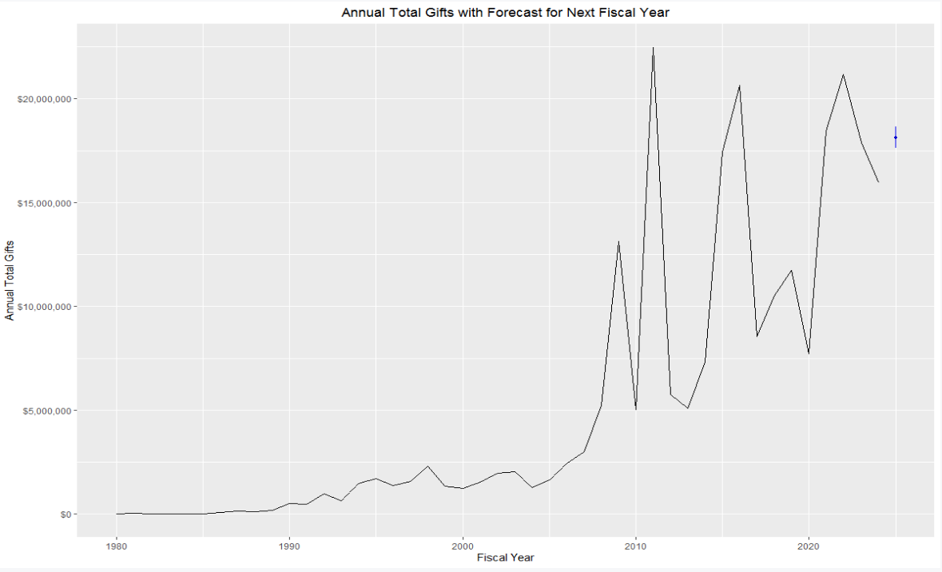

Slide 18
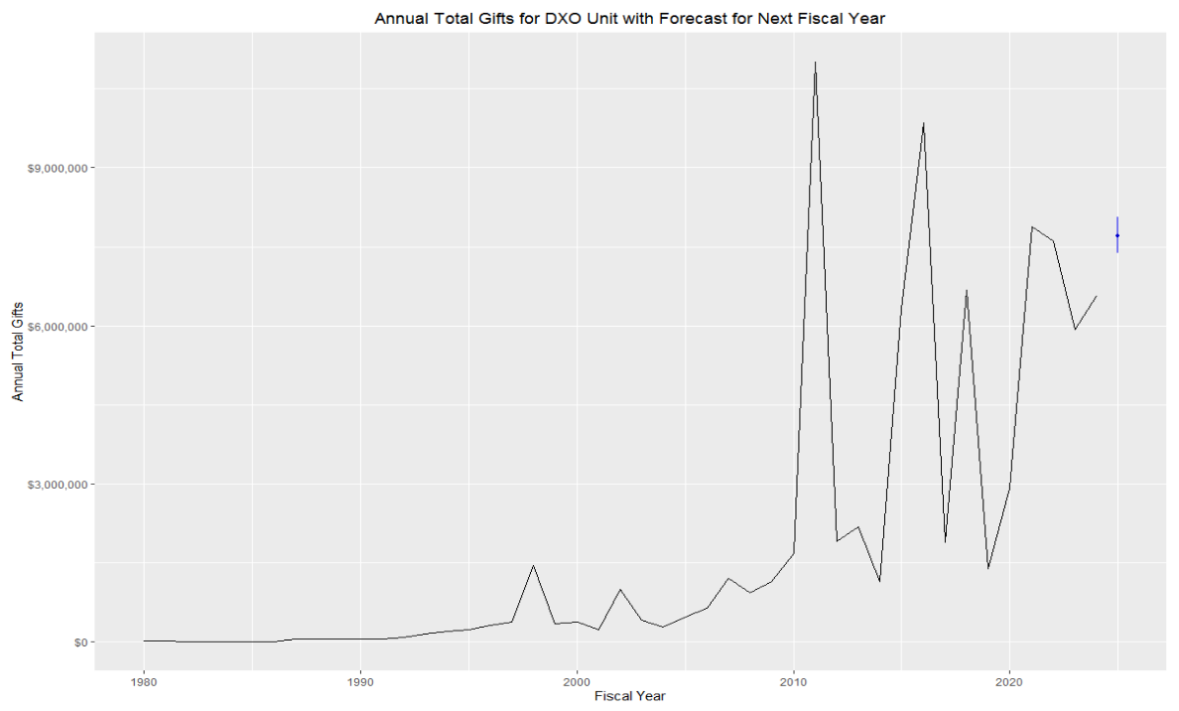

Slide 19
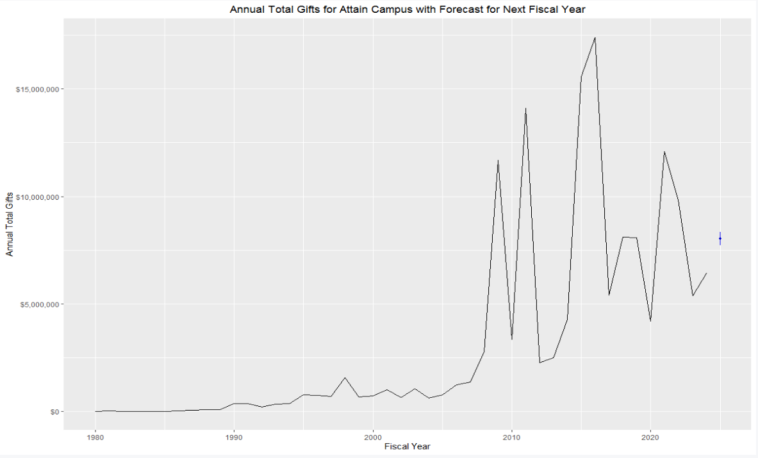

Slide 20
Campaign Goals
Total annual gifts are forecasted at $19.3m
Across five years (x5) = $96.8m

Slide 21
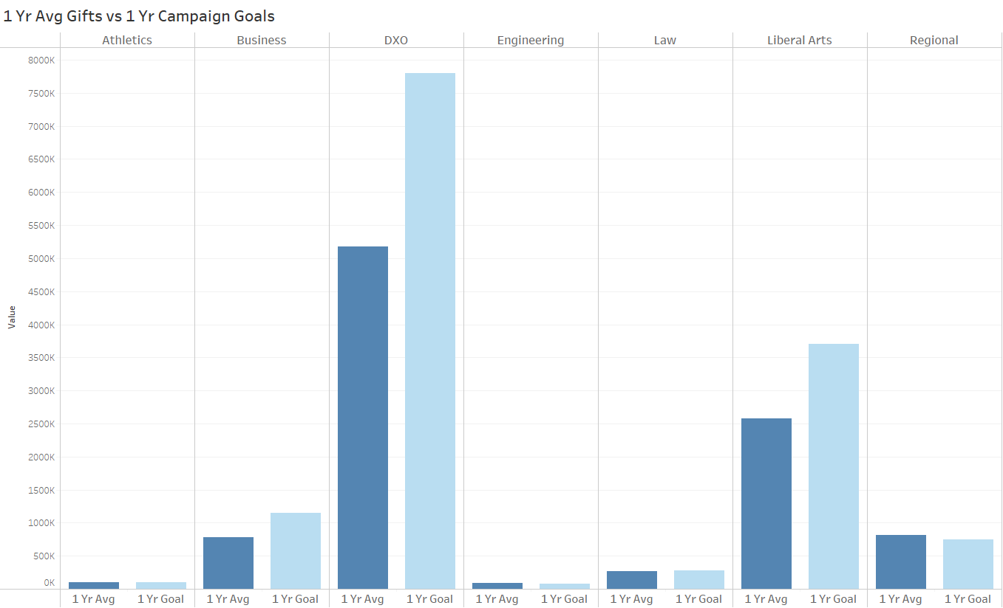
Campaign Goals

Slide 22
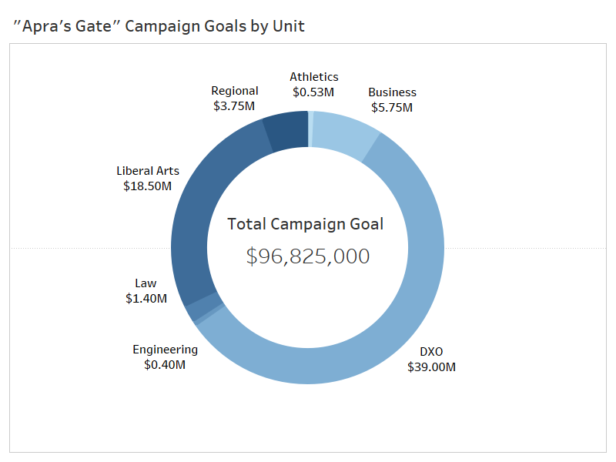
Campaign Goals

Slide 23
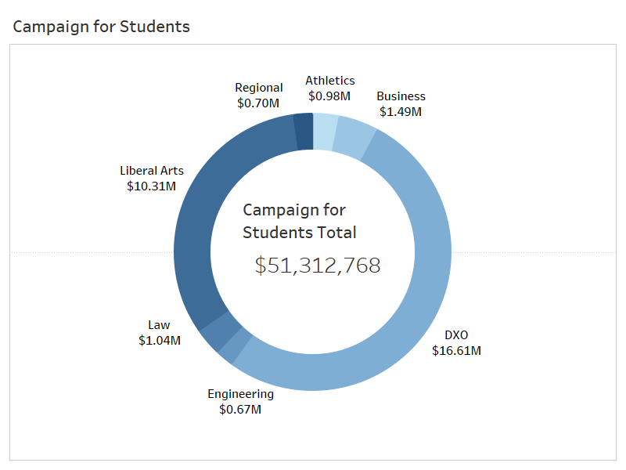
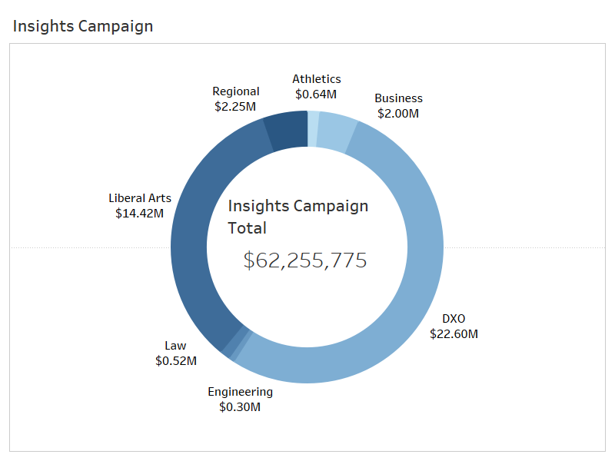

Slide 24
Comparing to prior campaigns
“Apra’s Gate” campaign is forecasting $19.3m per year
“Campaign for Students” (2005-2011) shows $8.5m a year
“Insights Campaign” (2011-2023) shows $5.1m a year
“Apra’s Gate” campaign should focus efforts to engage currently unassigned donors, roping in null gifts into the campaign

Slide 25
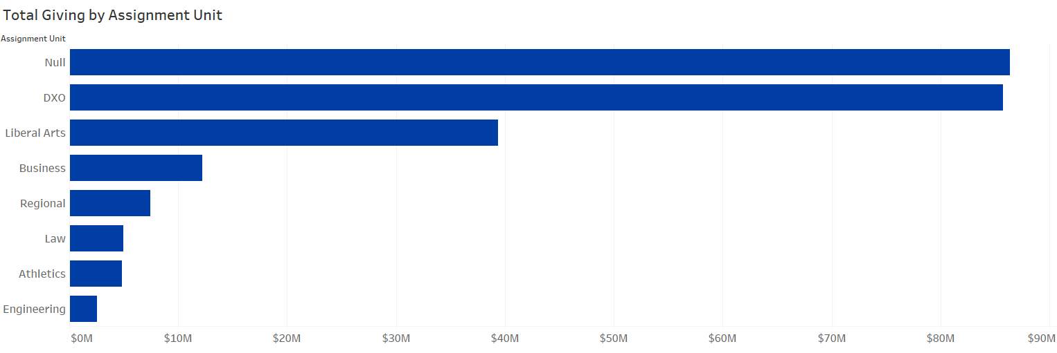

Slide 26
The Gift Pyramid
Based on a one-year target of $19.3m
Major Donors
Mid-level Donors
Low-level Donors
Prospective Donors

Slide 27
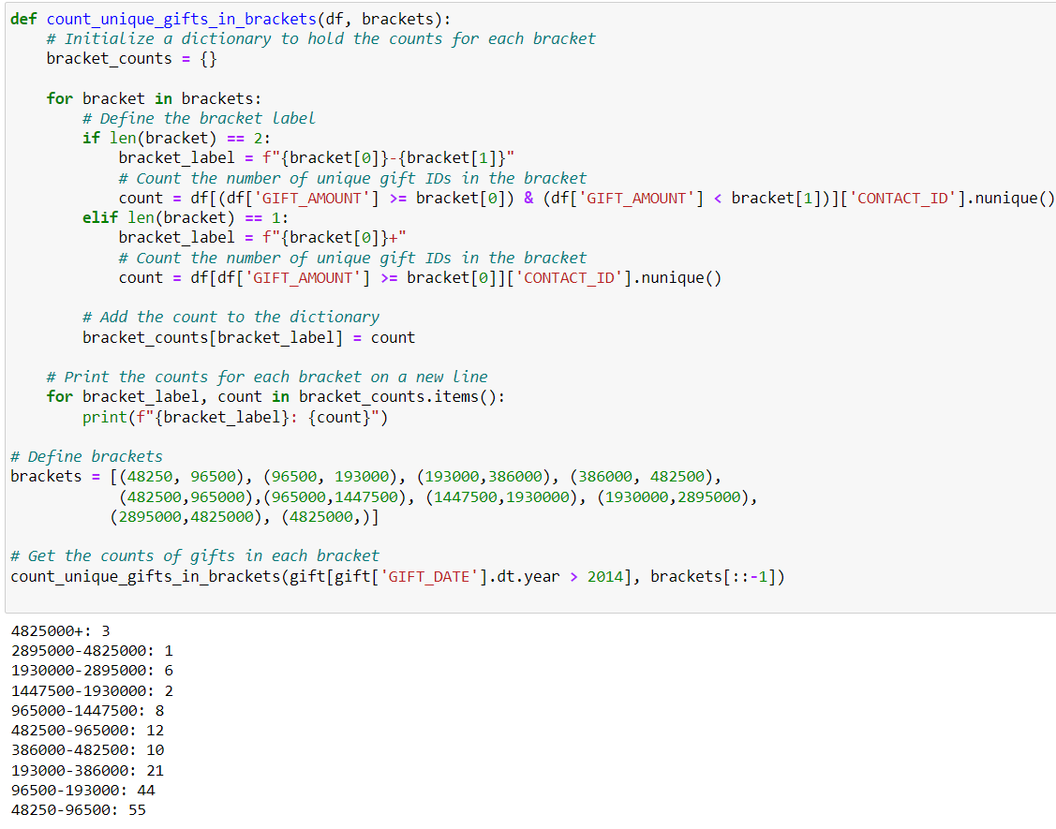
The Gift Pyramid
Verifying feasibility of gift brackets using donor activity from the last 10 years
Shows slight discrepancy towards higher brackets, but supported by a larger base in lower brackets

Slide 28
The Gift Pyramid
Lead Gifts
3 donors at $2.5m+
Major Gifts
21 donors at $500k
Mid-level Gifts
110 donors at $50k
Low-level Gifts
812 donors at $5000
Prospective/Annual
2323 donors at $500
Total max potential: $28,721,500 per year

Slide 29
“With Apra's Gate now open, the quest has begun in earnest.

Slide 30
“With Apra's Gate now open, the quest has begun in earnest. Fundraising knights in gleaming armor rally support across the realm, guided by the wise Analysts of the Round Table.

Slide 31
“With Apra's Gate now open, the quest has begun in earnest. Fundraising knights in gleaming armor rally support across the realm, guided by the wise Analysts of the Round Table. Inspired citizens contribute generously, their hearts alight with hope.

Slide 32
“With Apra's Gate now open, the quest has begun in earnest. Fundraising knights in gleaming armor rally support across the realm, guided by the wise Analysts of the Round Table. Inspired citizens contribute generously, their hearts alight with hope. As gold fills the coffers, the Kingdom of Apra marches towards a future of prosperity and promise.”

Slide 33
Play Apra’s Gate: the Video Game at the link below!

