Slide 1
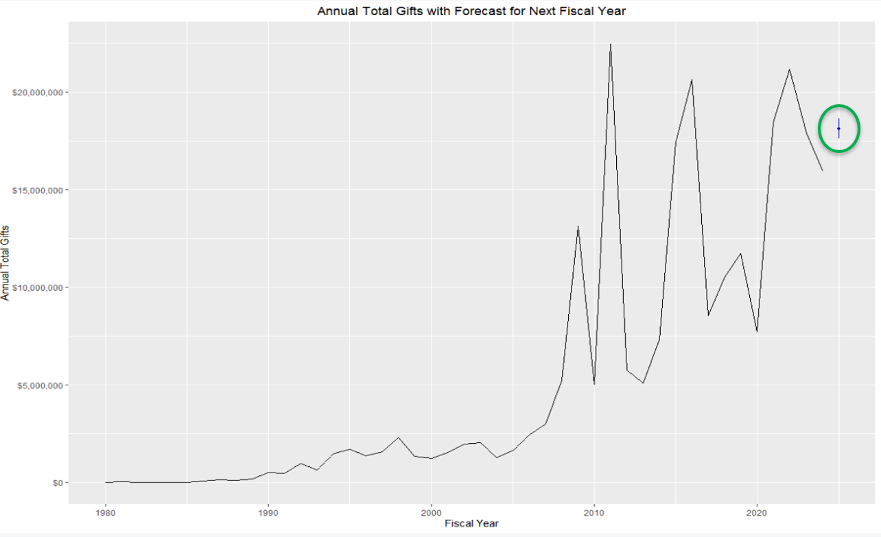
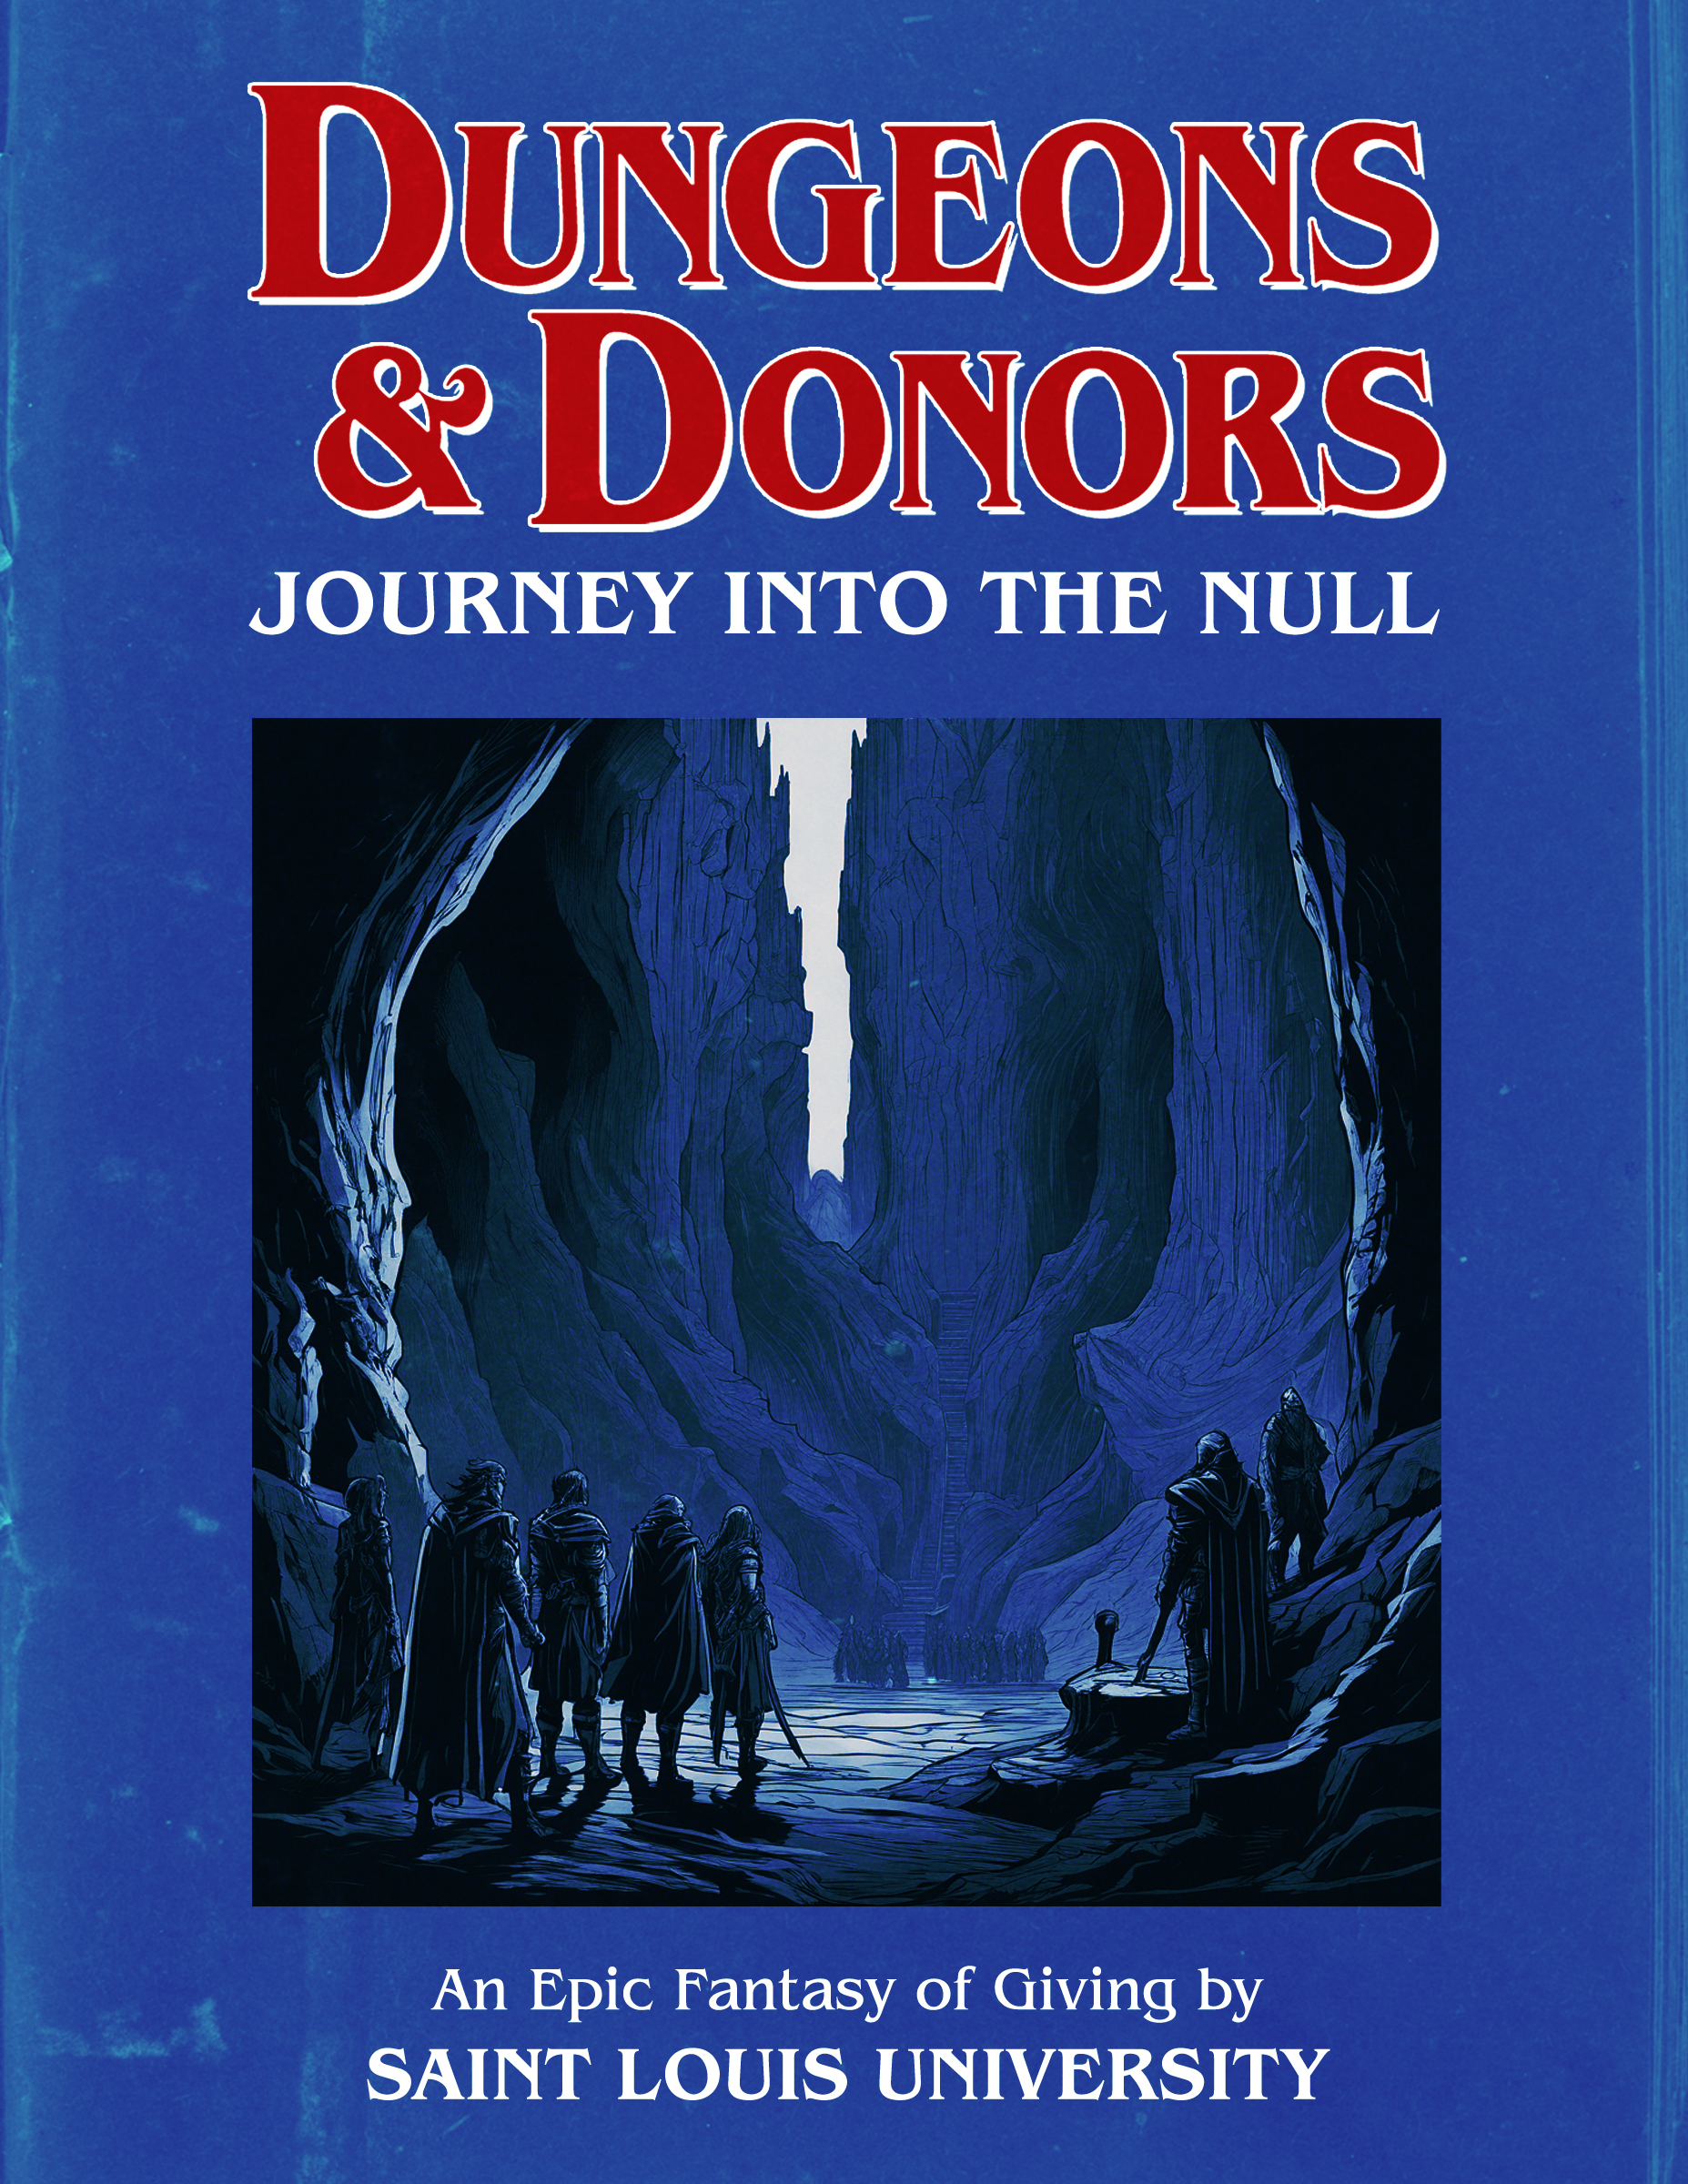
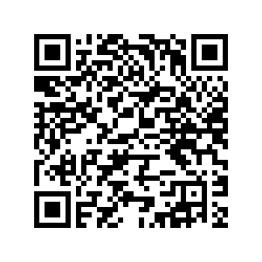
Dungeons & Donors Saint Louis University (Jenna Majzoub, Olive Buchholz, Peter Reiker, Bill Tran)
Image from submission
In this project, we build a 5-year campaign for this organization using data visualizations, time-series modeling, and a donor pyramid. We found that this organization has highly generous donors that require assignment and interaction and put forth recommendations accordingly.
R, Python, Tableau
jenna.majzoub@slu.edu
olive.buchholz@slu.edu
peter.reiker@slu.edu
william.tran@slu.edu
Based on our time-series model and historical context, we recommend a 5-year campaign with a total goal of $96.8M and a stretch goal of $106.5M. This goal is distributed across each assignment unit, with each unit responsible for a different portion according to past performance.
A focus should be put on engaging currently unassigned donors, as gifts from unassigned donors are a significant portion of this organization’s intake.
QR code placement
(Apra to create)

